Slide 1
Secure Data Hiding in Images using Steganography
CAPSTONE PROJECT
PRESENTED BY:
R. NANTHINI PRIYA
DEPARTMENT OF COMPUTER SCIENCE
ALAGAPPA UNIVERSITY , KARAIKUDI , TAMILNADU.

Slide 2
OUTLINE
Problem Statement
Technology used
Wow factor
End users
Result
Conclusion
Git-hub Link
Future scope

Slide 3
Problem Statement
Plainly visible encrypted messages, no matter how unbreakable they are, arouse interest and may in themselves be incriminating in countries in which encryption is illegal.
With steganography, the intended secret message does not attract attention to itself as an object of scrutiny.
Whereas cryptography is the practice of protecting the contents of a message alone, steganography is concerned with concealing both the fact that a secret message is being sent and its contents.

Slide 4
Technology used
Software requirements:
Python IDLE version 3.12.4
Language used:
Python
Library used:
Cv2

Slide 5
Wow factors
This project allows to hide secret messages or files within ordinary-looking images.
It can be designed to make the hidden message or file virtually undetectable, even with advanced forensic analysis.
It provides secure way to communicate sensitive information over public channels such as the internet, without arousing suspicion.
It is used in digital watermarking to embed hidden copyright information or ownership data into digital media.

Slide 6
End users
Military and Defense
Government Agencies
Corporations
Journalists and Reporters
Researchers and Academics
Law Enforcement
Intelligence Agencies

Slide 7

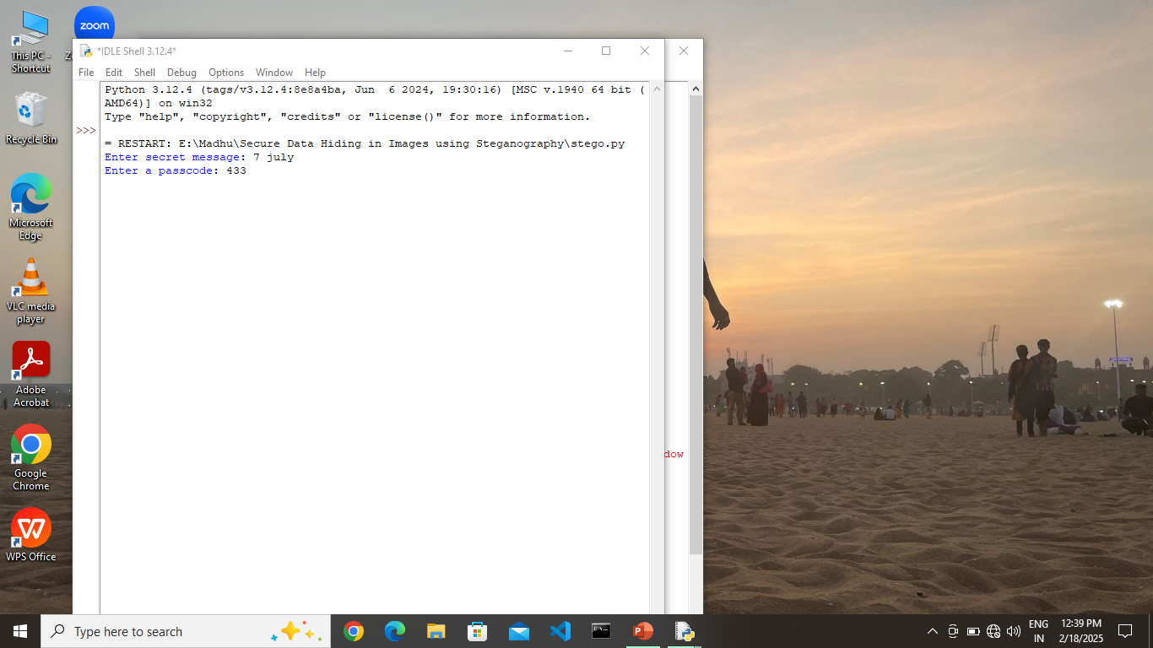

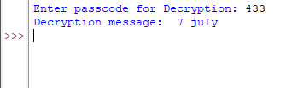
Results
i) Encryption
Original image(picture.jpg)
ii) Decryption
Encrypted image (encryptedImage.jpg)

Slide 8
Conclusion
This project demonstrates a simple yet effective way to hide secret messages within image files. By utilizing the least significant bit (LSB) substitution method, the project showcases the basics of steganography and its potential applications.

Slide 9
GitHub Link
https://github.com/Npstud17/SECURE-DATA-HIDING-IN-IMAGES-USING-STEGANOGRAPHY.git

Slide 10
Future scope
Expand the project to support steganography in other multimedia formats, such as audio or video files.
Explore the application of machine learning techniques to improve steganography detection and extraction.
Deploy the project on a cloud-based platform to enable scalable and on-demand access.
Implement collaborative editing features to enable multiple users to work on the same steganography project.

Slide 11
THANK YOU

